Slide 1
Submarine swaps
Example: Buying on-chain BTC via Lightning Network
Hash Time Locked Contracts (HTLCs)

Slide 2
Content
Example 1: Submarine swap for in-bound liquidity problem
Recap: Classical Lightning payments using HTLCs
Creating a submarine swap (explained for in-bound liquidity problem)
Example 2: Bridge out of lightning (without channel close)
Revealing HTLC preimage order
Example 3: Paying a Lightning invoice on-chain via swap provider
Limitations of submarine swaps

Slide 3









Example 1: Submarine swap for in-bound liquidity problem
Thomas is a Lightning Network merchant.
He received many payments. His inbound liquidity is shrinking. One customer is Sandra.

Slide 4
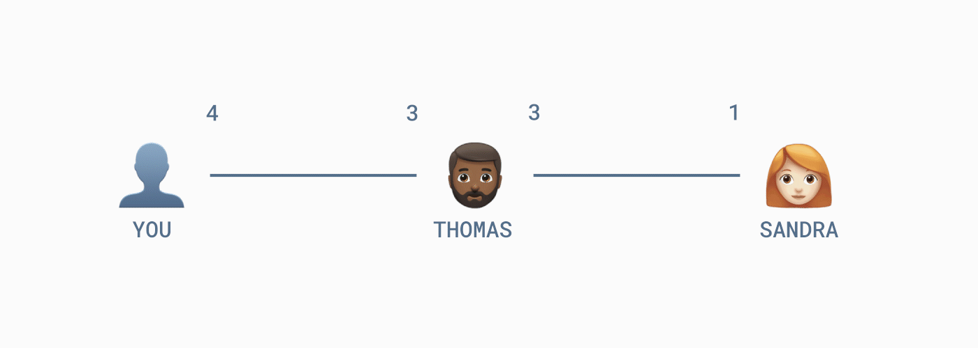
Recap: Classical Lightning payments using HTLCs
https://blog.muun.com/a-closer-look-at-submarine-swaps-in-the-lightning-network/
Solution to Thomas’ inbound liquidity problem:
Pay Sandra so that Thomas’ balance on her side increases again.

Slide 5

Creating a submarine swap
Sandra is Lightning seller (Thomas pays her in exchange for on-chain coins) → she must create H(P)
Sandra creates HTLC-locked (TimeLock: block 750 000) on-chain TX with H(P) paying Thomas 1 BTC
Thomas creates Lightning TX (TimeLock: block 749 990) with H(P) paying Sandra 1 BTC
Sandra must claim 1 BTC from Lightning TX (revealing P) before block 749 990
Thomas claims 1 BTC on-chain using P
 | Lightning TX | from Thomas to Sandra | off-chain
 | Input 0 (funding TX)
 | sig Thomas ✓ sig Sandra ⬜ |  | 4 BTC
 | Output 0 (HTLC)
 | Sandra 🔒 OP_HASH H(P) OP_EQUAL ⏳ 10 (blocks) OP_CSV | Thomas 📅 749 990 (block) OP_CLTV | 1 BTC
 | Output 1 (Sandra’s balance)
 | Sandra ⏳ 10 (blocks) OP_CSV | Thomas 🔒 – REVOCATION – | 1 BTC
 | Output 3 (Thomas’ balance)
 | Thomas |  | 2 BTC
 | Bitcoin TX | from Sandra to Thomas | on-chain
 | Input 0 (funding TX)
 | sig Sandra ✓ |  | 1 BTC
 | Output 0 (HTLC)
 | Thomas 🔒 OP_HASH H(P) OP_EQUAL | Sandra 📅 750 000 (block) OP_CLTV | 1 BTC
Step 2
Step 3

Slide 6
Creating a submarine swap
https://www.youtube.com/watch?v=qixhNBIHDyE
Bitcoin on-chain TX Opcode
OP_HASH160
<ripemd160(swapHash)>
OP_EQUAL
OP_IF
<receiverHtlcKey>
OP_ELSE
<cltv timeout>
OP_CHECKLOCKTIMEVERIFY
OP_DROP
<senderHtlcKey>
OP_ENDIF
OP_CHECKSIG
 | Bitcoin TX | from Sandra to Thomas | on-chain
 | Input 0 (funding TX)
 | sig Sandra ✓ |  | 1 BTC
 | Output 0 (HTLC)
 | Thomas 🔒 OP_HASH H(P) OP_EQUAL | Sandra 📅 750 000 (block) OP_CLTV | 1 BTC

Slide 7
Creating a submarine swap (improved)
https://docs.lightning.engineering/the-lightning-network/lightning-overview/understanding-submarine-swaps
(Checking size of preimage might be necessary (especially before allowing senderHtlcKey to redeem the funds!) so that the preimage has the correct size and contract works.)
Bitcoin on-chain TX Opcode
OP_SIZE 32 OP_EQUAL
OP_IF
OP_HASH160
<ripemd160(swapHash)>
OP_EQUALVERIFY
<receiverHtlcKey>
OP_ELSE
OP_DROP (drop the preimage)
<cltv timeout>
OP_CHECKLOCKTIMEVERIFY
OP_DROP
<senderHtlcKey>
OP_ENDIF
OP_CHECKSIG
 | Bitcoin TX | from Sandra to Thomas | on-chain
 | Input 0 (funding TX)
 | sig Sandra ✓ |  | 1 BTC
 | Output 0 (HTLC)
 | Thomas 🔒 OP_HASH H(P) OP_EQUAL | Sandra 📅 750 000 (block) OP_CLTV | 1 BTC

Slide 8
Example 2: Bridge out of lightning (without channel close)
Thomas wants to bridge out of Lighting = “Sells” Lightning balance
for on-chain balance
Technically the same as in-bound liquidity problem:
 | Lightning TX | from Thomas to Sandra | off-chain
 | Input 0 (funding TX)
 | sig Thomas ✓ sig Sandra ⬜ |  | 4 BTC
 | Output 0 (HTLC)
 | Sandra 🔒 OP_HASH H(P) OP_EQUAL ⏳ 10 (blocks) OP_CSV | Thomas 📅 749 990 (block) OP_CLTV | 1 BTC
 | Output 1 (Sandra’s balance)
 | Sandra ⏳ 10 (blocks) OP_CSV | Thomas 🔒 – REVOCATION – | 1 BTC
 | Output 3 (Thomas’ balance)
 | Thomas |  | 2 BTC
 | Bitcoin TX | from Sandra to Thomas | on-chain
 | Input 0 (funding TX)
 | sig Sandra ✓ |  | 1 BTC
 | Output 0 (HTLC)
 | Thomas 🔒 OP_HASH H(P) OP_EQUAL | Sandra 📅 750 000 (block) OP_CLTV | 1 BTC

Slide 9
Revealing HTLC preimage order
The preimage could also be revealed on-chain first. In this case, Thomas is the creator of H(P). He must reveal the preimage on-chain first, before Sandra can claim the money off-chain on Lightning.
 | Lightning TX | from Thomas to Sandra | off-chain
 | Input 0 (funding TX)
 | sig Thomas ✓ sig Sandra ⬜ |  | 4 BTC
 | Output 0 (HTLC)
 | Sandra 🔒 OP_HASH H(P) OP_EQUAL ⏳ 10 (blocks) OP_CSV | Thomas 📅 750 000 (block) OP_CLTV | 1 BTC
 | Output 1 (Sandra’s balance)
 | Sandra ⏳ 10 (blocks) OP_CSV | Thomas 🔒 – REVOCATION – | 1 BTC
 | Output 3 (Thomas’ balance)
 | Thomas |  | 2 BTC
 | Bitcoin TX | from Sandra to Thomas | on-chain
 | Input 0 (funding TX)
 | sig Sandra ✓ |  | 1 BTC
 | Output 0 (HTLC)
 | Thomas 🔒 OP_HASH H(P) OP_EQUAL ⏳ 10 (blocks) OP_CSV | Sandra 📅 749 990 (block) OP_CLTV | 1 BTC

Slide 10
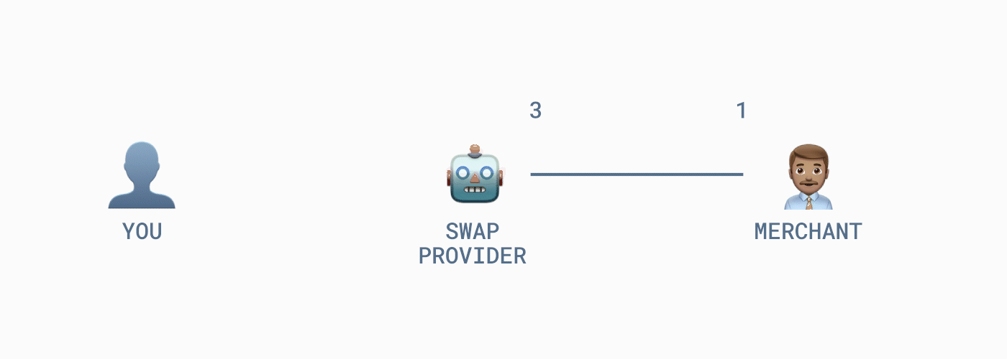
Example 3: Paying a Lightning invoice on-chain via swap provider
Merchant must create H(P)
You create HTLC-locked (TimeLock: block 750 000) on-chain TX with H(P) paying 1 BTC to Swap Provider
Swap Provider creates Lightning TX (TimeLock: block 749 990) with H(P) paying Merchant 1 BTC
Merchant must claim Lightning amount (revealing P) before block 749 990
Swap Provider claims 1 BTC on-chain using P

Slide 11
Limitations of submarine swaps
On-chain costs (+ Lightning costs)
Privacy (everyone can see UTXO and preimage)
Time (not instant payments) because of on-chain confirmations
Solutions to decrease I. costs and increase II. privacy:
Taproot with signature aggregation and tapscript.

